Slide 1
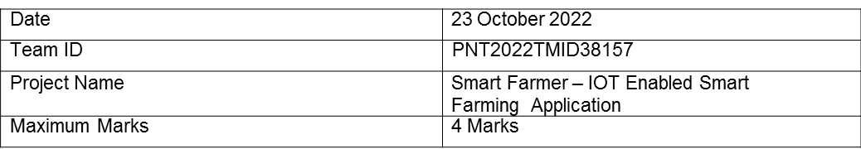

Project Design Phase - 1
Problem Solution Fit
into CC
differentiate
1. S NT S
Who is your customer?
i.e. working parents of 0-5 y.o. kids
6. O
CC
AS
CS
What constraints prevent your customers from taking action or limit
of solutions? i.e. spending power, budget, no cash, network connection, available devices.
Which solutions are available to the customer when they face the problem
or need to get the job done? What have they tried in the past? What pros & cons do these solutions have? i.e. pen and paper
A farmer who raises crops is the target market for this product. Our intention is to assist them by remotely monitoring field conditions. This product prevents the demise of agriculture.
It is challenging to use many sensors. Success requires an unrestricted or ongoing internet connection.
Using IoT, the irrigation process is automated. To automate the watering operation, field parameters and meteorological data were gathered and processed. Efficiency is limited over small distances, and data storage is challenging.
Focus on J&P, tap into BE, understand RC
Focus on J&P, tap into BE, understand RC
2. JOBS-TO-BE-DONE / PROBLEMS
Which jobs-to-be-done (or problems) do you address for o c ome There co be mo o o
J&P
9. ROBLE ROOT
What is the real reason that this problem exists? What is the back story behind the need to do this job?
RC
7. BEHAVIOUR
What does your customer do to address the problem and get the job done?
i.e directly related: ﬁnd the right solar panel installer, calculate
usage and beneﬁts; indirectly associated: customers spend free time on volunteering work (i.e. Green peace)
BE
This product's function is to employ sensors to collect different field parameters and then process them
It was hard for farmers to perform agriculture because of the often changing and uncertain weather and climate. When deciding whether to water your plants, these factors are crucial. When a farmer isn't there, it's hard to keep an eye on the field, which can cause crop damage.
To counteract the consequences of extra water from heavy rain, use a suitable drainage system. the use of pest-resistant hybrid plants.
using a centralized processing
system. IoT uses the cloud to send
and store data. Farmers utilize the Weather API to aid in choice.
With the use of mobile applications, farmer make s judge.

Slide 2
